Slide 1
Module 1: Cloud Concepts Overview
AWS Academy Cloud Foundations
Notes:
Welcome to Module 1: Cloud Concepts Overview.

Slide 2

Module overview
Topics
Introduction to cloud computing
Advantages of cloud computing
Introduction to Amazon Web Services (AWS)
AWS Cloud Adoption Framework (AWS CAF)
Knowledge check
Notes:
This module addresses the following topics:
Introduction to cloud computing
Advantages of cloud computing
Introduction to Amazon Web Services (AWS)
AWS Cloud Adoption Framework (AWS CAF)
Finally, you will be asked to complete a knowledge check that will be used to test your understanding of the key concepts that are covered in this module.

Slide 3
Module objectives
After completing this module, you should be able to:
Define different types of cloud computing models
Describe six advantages of cloud computing
Recognize the main AWS service categories and core services
Review the AWS Cloud Adoption Framework (AWS CAF)
Notes:
After completing this module, you should be able to:
Define different types of cloud computing
Describe six advantages of cloud computing
Recognize the main AWS service categories and core services
Review the AWS Cloud Adoption Framework (AWS CAF)

Slide 4
Section 1: Introduction to cloud computing
Module 1: Cloud Concepts Overview
Notes:
Section 1: Introduction to cloud computing

Slide 5
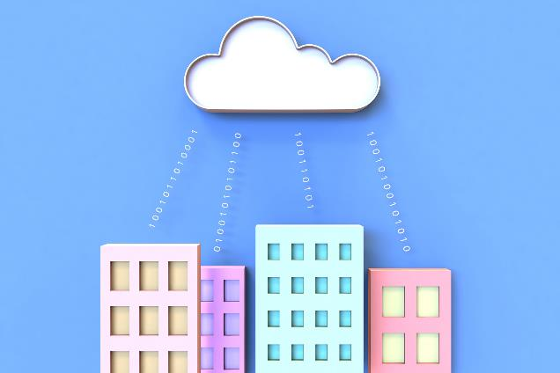
What is cloud computing?
Notes:
What does cloud computing mean to you?
Take a moment to think of what cloud computing means to you and write a short sentence.

Slide 6
Cloud computing defined
Cloud computing is the on-demand delivery of compute power, database, storage, applications, and other IT resources via the internet with pay-as-you-go pricing.
Notes:
Cloud computing is the on-demand delivery of compute power, database, storage, applications, and other IT resources via the internet with pay-as-you-go pricing. These resources run on server computers that are located in large data centers in different locations around the world. When you use a cloud service provider like AWS, that service provider owns the computers that you are using. These resources can be used together like building blocks to build solutions that help meet business goals and satisfy technology requirements.
To learn more about cloud computing and how it works, see https://aws.amazon.com/what-is-cloud-computing/.

Slide 7
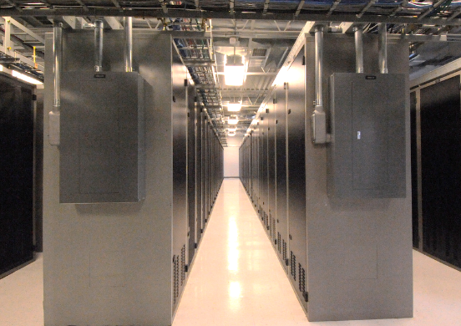

Infrastructure as software
Cloud computing enables you to stop thinking of your infrastructure as hardware, and instead think of (and use) it as software.
Notes:
Cloud computing enables you to stop thinking of your infrastructure as hardware, and instead think of (and use) it as software. But what does this mean?

Slide 8
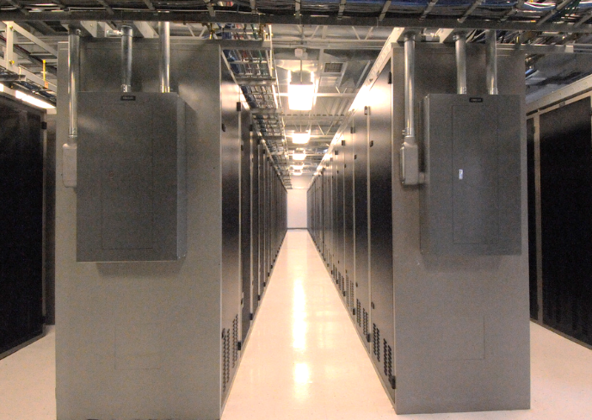
Traditional computing model
Infrastructure as hardware
Hardware solutions:
Require space, staff, physical security, planning, capital expenditure
Have a long hardware procurement cycle
Require you to provision capacity by guessing theoretical maximum peaks
Notes:
In the traditional computing model, infrastructure is thought of as hardware. Hardware solutions are physical, which means they require space, staff, physical security, planning, and capital expenditure.
In addition to significant upfront investment, another prohibitive aspect of traditional computing is the long hardware procurement cycle that involves acquiring, provisioning, and maintaining on-premises infrastructure.
With a hardware solution, you must ask if there is enough resource capacity or sufficient storage to meet your needs, and you provision capacity by guessing theoretical maximum peaks. If you don’t meet your projected maximum peak, then you pay for expensive resources that stay idle. If you exceed your projected maximum peak, then you don’t have sufficient capacity to meet your needs. And if your needs change, then you must spend the time, effort, and money required to implement a new solution.
For example, if you wanted to provision a new website, you would need to buy the hardware, rack and stack it, put it in a data center, and then manage it or have someone else manage it. This approach is expensive and time-consuming.

Slide 9

Cloud computing model
Infrastructure as software
Software solutions:
Are flexible
Can change more quickly, easily, and cost-effectively than hardware solutions
Eliminate the undifferentiated heavy-lifting tasks
Notes:
By contrast, cloud computing enables you to think of your infrastructure as software. Software solutions are flexible. You can select the cloud services that best match your needs, provision and terminate those resources on-demand, and pay for what you use. You can elastically scale resources up and down in an automated fashion. With the cloud computing model, you can treat resources as temporary and disposable. The flexibility that cloud computing offers enables businesses to implement new solutions quickly and with low upfront costs.
Compared to hardware solutions, software solutions can change much more quickly, easily, and cost-effectively.
Cloud computing helps developers and IT departments avoid undifferentiated work like procurement, maintenance, and capacity planning, thus enabling them to focus on what matters most.
As cloud computing has grown in popularity, several different service models and deployment strategies have emerged to help meet the specific needs of different users. Each type of cloud service model and deployment strategy provides you with a different level of control, flexibility, and management. Understanding the differences between these cloud service models and deployment strategies can help you decide what set of services is right for your needs.

Slide 10
Cloud service models
IaaS
(infrastructure as a service)
PaaS
(platform as a service)
SaaS
(software as a service)
More control over IT resources
Less control over IT resources
Notes:
There are three main cloud service models. Each model represents a different part of the cloud computing stack and gives you a different level of control over your IT resources:
Infrastructure as a service (IaaS): Services in this category are the basic building blocks for cloud IT and typically provide you with access to networking features, computers (virtual or on dedicated hardware), and data storage space. IaaS provides you with the highest level of flexibility and management control over your IT resources. It is the most similar to existing IT resources that many IT departments and developers are familiar with today.
Platform as a service (PaaS): Services in this category reduce the need for you to manage the underlying infrastructure (usually hardware and operating systems) and enable you to focus on the deployment and management of your applications.
Software as a service (SaaS): Services in this category provide you with a completed product that the service provider runs and manages. In most cases, software as a service refers to end-user applications. With a SaaS offering, you do not have to think about how the service is maintained or how the underlying infrastructure is managed. You need to think only about how you plan to use that particular piece of software. A common example of a SaaS application is web-based email, where you can send and receive email without managing feature additions to the email product or maintaining the servers and operating systems that the email program runs on.

Slide 11
SAAS
SaaS—also known as cloud-based software or cloud applications—is application software that’s hosted in the cloud, and that users access via a web browser, a dedicated desktop client, or an API that integrates with a desktop or mobile operating system. In most cases, SaaS users pay a monthly or annual subscription fee; some may offer ‘pay-as-you-go’ pricing based on your actual usage.
Automatic upgrades: With SaaS, users take advantage of new features as soon as the provider adds them, without having to orchestrate an on-premises upgrade.
Protection from data loss: Because SaaS stores application data in the cloud with the application, users don’t lose data if their device crashes or breaks.

Slide 12
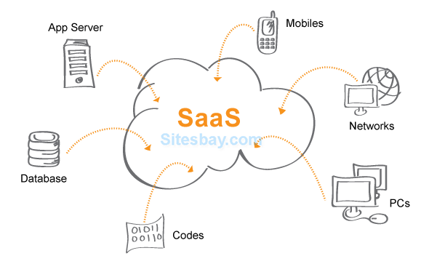

Slide 13
PAAS
PaaS provides software developers with on-demand platform—hardware, complete software stack, infrastructure, and even development tools—for running, developing, and managing applications without the cost, complexity, and inflexibility of maintaining that platform on-premises.
With PaaS, the cloud provider hosts everything—servers, networks, storage, operating system software, middleware, databases—at their data center. Developers simply pick from a menu to ‘spin up’ servers and environments they need to run, build, test, deploy, maintain, update, and scale applications.

Slide 14
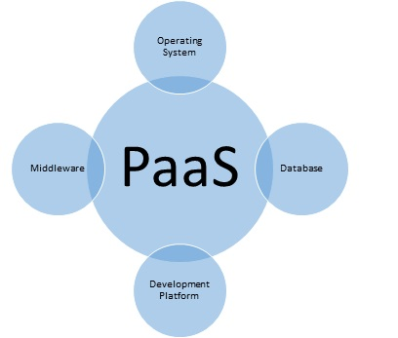

Slide 15
IAAS
IaaS provides on-demand access to fundamental computing resources—physical and virtual servers, networking, and storage—over the internet on a pay-as-you-go basis. IaaS enables end users to scale and shrink resources on an as-needed basis, reducing the need for high, up-front capital expenditures or unnecessary on-premises or ‘owned’ infrastructure and for overbuying resources to accommodate periodic spikes in usage.
In contrast to SaaS and PaaS (and even newer PaaS computing models such as containers and serverless), IaaS provides the users with the lowest-level control of computing resources in the cloud.

Slide 16
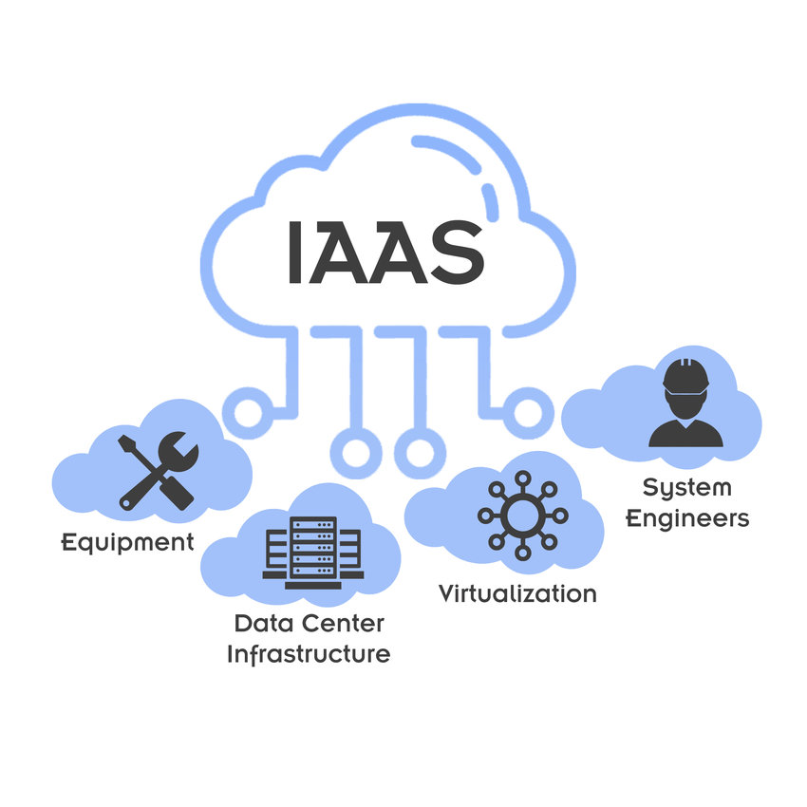

Slide 17
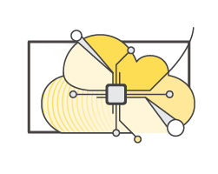
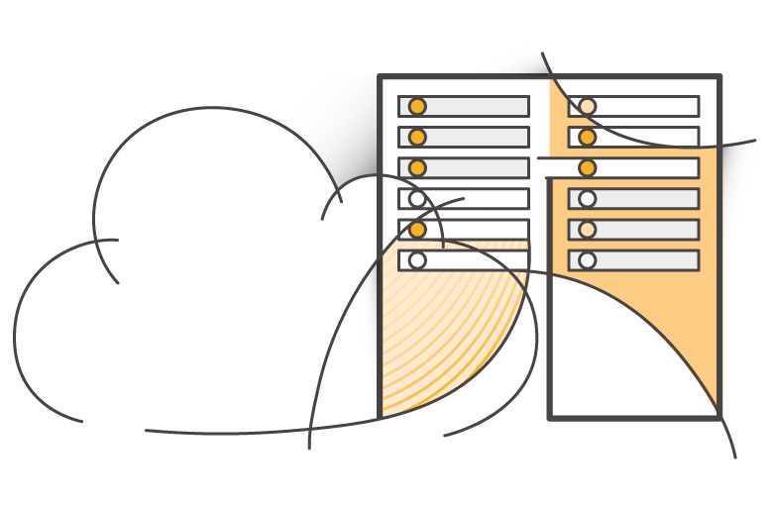
Cloud computing deployment models
Cloud
Hybrid
On-premises (private cloud)
Notes:
There are three main cloud computing deployment models, which represent the cloud environments that your applications can be deployed in:
Cloud: A cloud-based application is fully deployed in the cloud, and all parts of the application run in the cloud. Applications in the cloud have either been created in the cloud or have been migrated from an existing infrastructure to take advantage of the benefits of cloud computing (see https://aws.amazon.com/what-is-cloud-computing/). Cloud-based applications can be built on low-level infrastructure pieces or they can use higher-level services that provide abstraction from the management, architecting, and scaling requirements of core infrastructure.
Hybrid: A hybrid deployment is a way to connect infrastructure and applications between cloud-based resources and existing resources that are not located in the cloud. The most common method of hybrid deployment is between the cloud and existing on-premises infrastructure. This model enables an organization to extend and grow their infrastructure into the cloud while connecting cloud resources to internal systems.
On-premises: Deploying resources on-premises, using virtualization and resource management tools, is sometimes called private cloud. While on-premises deployment does not provide many of the benefits of cloud computing, it is sometimes sought for its ability to provide dedicated resources. In most cases, this deployment model is the same as legacy IT infrastructure, but it might also use application management and virtualization technologies to increase resource utilization.

Slide 18
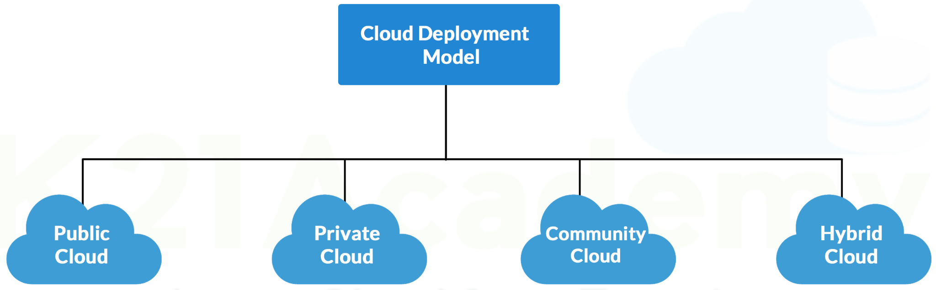
What is a Cloud Deployment Model?
Cloud Deployment Model functions as a virtual computing environment with a deployment architecture that varies depending on the amount of data you want to store and who has access to the infrastructure.

Slide 19
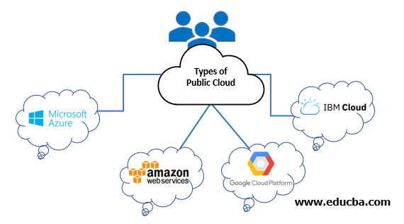
Public Cloud
The public cloud makes it possible for anybody to access systems and services. The public cloud may be less secure as it is open to everyone. The public cloud is one in which cloud infrastructure services are provided over the internet to the general people or major industry groups. The infrastructure in this cloud model is owned by the entity that delivers the cloud services, not by the consumer. It is a type of cloud hosting that allows customers and users to easily access systems and services. This form of cloud computing is an excellent example of cloud hosting, in which service providers supply services to a variety of customers. In this arrangement, storage backup and retrieval services are given for free, as a subscription, or on a per-user basis. For example, Google App Engine etc.

Slide 20
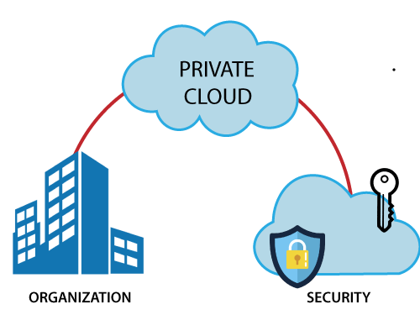
PRIVATE CLOUD
The private cloud deployment model is the exact opposite of the public cloud deployment model. It’s a one-on-one environment for a single user (customer). There is no need to share your hardware with anyone else. The distinction between private and public clouds is in how you handle all of the hardware. It is also called the “internal cloud” & it refers to the ability to access systems and services within a given border or organization.

Slide 21
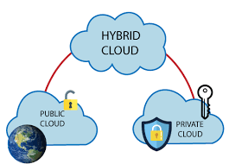
Hybrid Cloud
By bridging the public and private worlds with a layer of proprietary software, hybrid cloud computing gives the best of both worlds. With a hybrid solution, you may host the app in a safe environment while taking advantage of the public cloud’s cost savings. Organizations can move data and applications between different clouds using a combination of two or more cloud deployment methods, depending on their needs.

Slide 22
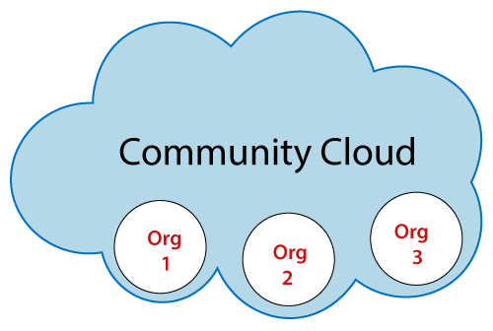
Community Cloud
It allows systems and services to be accessible by a group of organizations. It is a distributed system that is created by integrating the services of different clouds to address the specific needs of a community, industry, or business. The infrastructure of the community could be shared between the organization which has shared concerns or tasks. It is generally managed by a third party or by the combination of one or more organizations in the community.

Slide 23
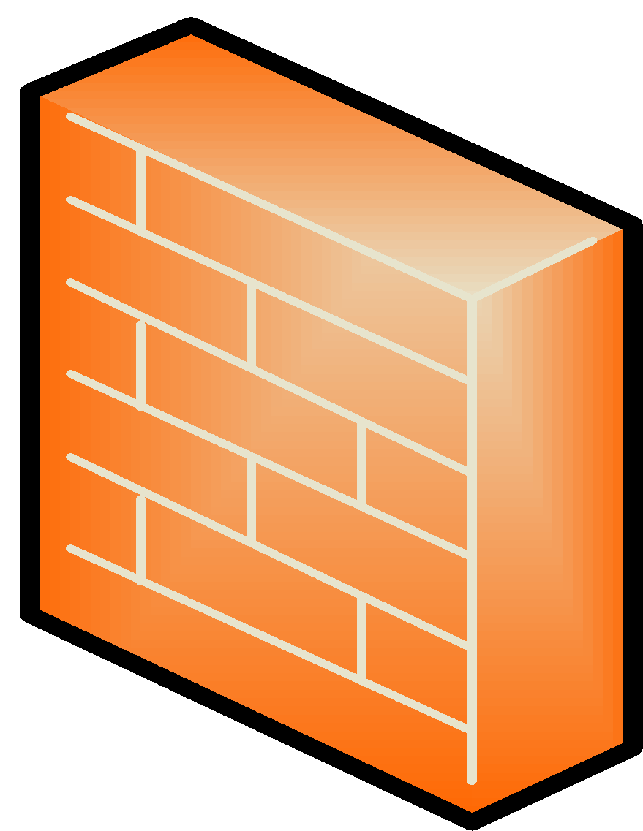





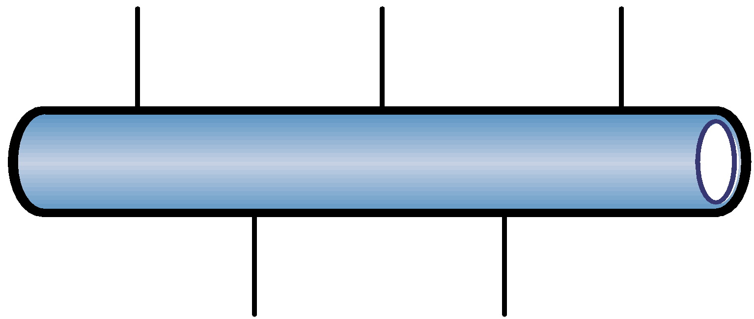






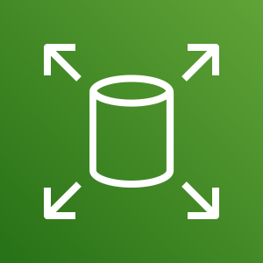
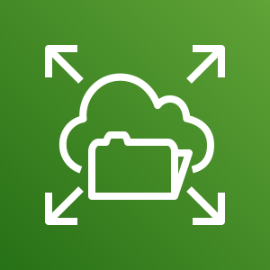

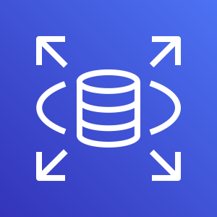

Similarities between AWS and traditional IT
Traditional, on-premises IT space
AWS
Security
Security groups
Firewalls
ACLs
Administrators
Network ACLs
IAM
Networking
Router
Network pipeline
Switch
Elastic Load Balancing
Amazon VPC
On-premises servers
Compute
AMI
Amazon EC2 instances
Storage and database
DAS
SAN
NAS
RDBMS
Amazon EBS
Amazon EFS
Amazon S3
Amazon RDS
Notes:
There are many similarities between AWS and the traditional, on-premises IT space:
AWS security groups, network access control lists (network ACLs), and AWS Identity and Access Management (IAM) are similar to firewalls, access control lists (ACLs), and administrators.
Elastic Load Balancing and Amazon Virtual Private Cloud (Amazon VPC) are similar to routers, network pipelines, and switches.
Amazon Machine Images (AMIs) and Amazon Elastic Compute Cloud (Amazon EC2) instances are similar to on-premises servers.
Amazon Elastic Block Store (Amazon EBS), Amazon Elastic File System (Amazon EFS), Amazon Simple Storage Service (Amazon S3), and Amazon Relational Database Service (Amazon RDS) are similar to direct attached storage (DAS), storage area networks (SAN), network attached storage (NAS), and a relational database management service (RDBMS).
With AWS services and features, you can do almost everything that you would want to do with a traditional data center.

Slide 24

Section 1 key takeaways
Cloud computing is the on-demand delivery of IT resources via the internet with pay-as-you-go pricing.
Cloud computing enables you to think of (and use) your infrastructure as software.
There are three cloud service models: IaaS, PaaS, and SaaS.
There are three cloud deployment models: cloud, hybrid, and on-premises or private cloud.
Almost anything you can implement with traditional IT can also be implemented as an AWS cloud computing service.
Notes:
Some key takeaways from this section of the module include:
Cloud computing is the on-demand delivery of IT resources via the internet with pay-as-you-go pricing.
Cloud computing enables you to think of (and use) your infrastructure as software.
There are three cloud service models: IaaS, PaaS, and SaaS.
There are three cloud deployment models: cloud, hybrid, and on-premises or private cloud.
There are many AWS service analogs for the traditional, on-premises IT space.

Slide 25
Section 2: Advantages of cloud computing
Module 1: Cloud Concepts Overview
Notes:
Section 2: Advantages of cloud computing
Why are so many companies interested in moving to the cloud? This section presents six advantages of cloud computing.

Slide 26


Trade capital expense for variable expense
Capital
Data center investment based on forecast
Pay only for the amount you consume
Notes:
Advantage #1—Trade capital expense for variable expense: Capital expenses (capex) are funds that a company uses to acquire, upgrade, and maintain physical assets such as property, industrial buildings, or equipment. Do you remember the data center example in the traditional computing model where you needed to rack and stack the hardware, and then manage it all? You must pay for everything in the data center whether you use it or not.
By contrast, a variable expense is an expense that the person who bears the cost can easily alter or avoid. Instead of investing heavily in data centers and servers before you know how you will use them, you can pay only when you consume resources and pay only for the amount you consume. Thus, you save money on technology. It also enables you to adapt to new applications with as much space as you need in minutes, instead of weeks or days. Maintenance is reduced, so you can spend focus more on the core goals of your business.

Slide 27

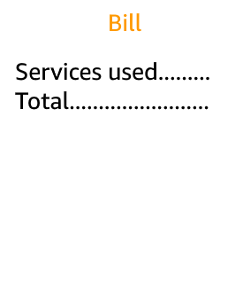


Massive economies of scale
Because of aggregate usage from all customers, AWS can achieve higher economies of scale and pass savings on to customers.
AWS Cloud
Economies of scale
Savings
Notes:
Advantage #2—Benefit from massive economies of scale: By using cloud computing, you can achieve a lower variable cost than you can get on your own. Because usage from hundreds of thousands of customers is aggregated in the cloud, providers such as AWS can achieve higher economies of scale, which translates into lower pay-as-you-go prices.

Slide 28
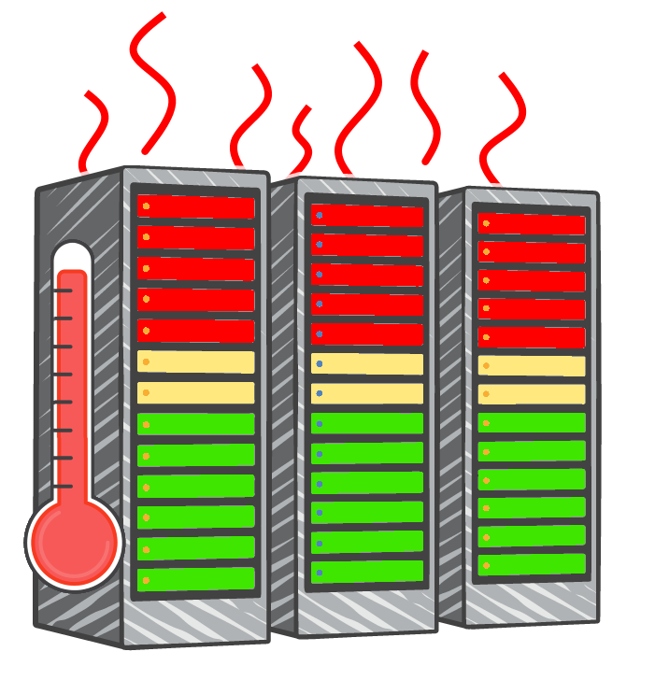
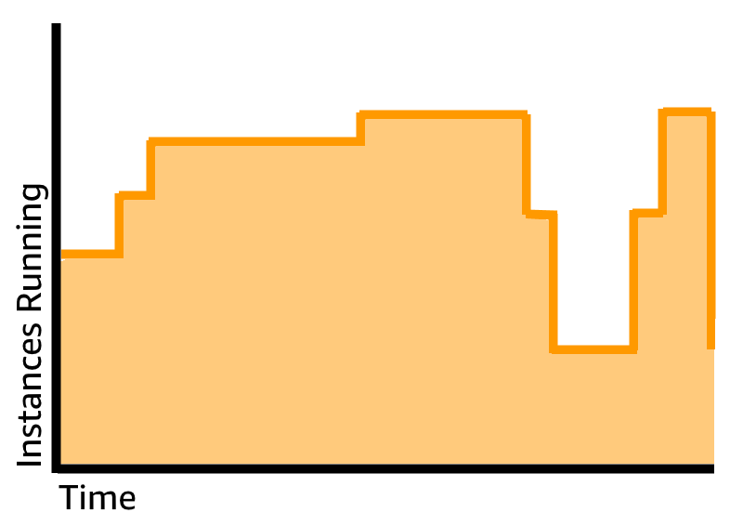
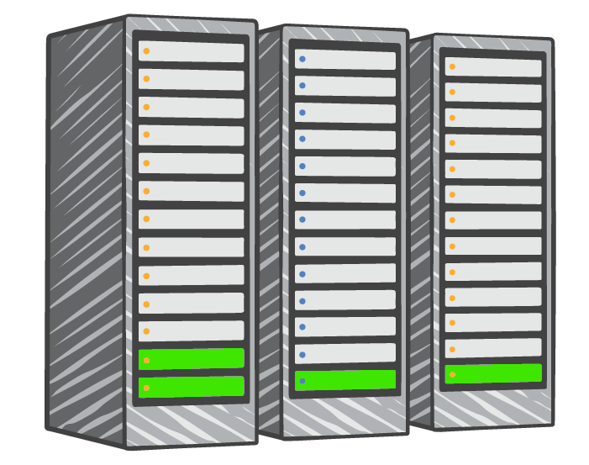
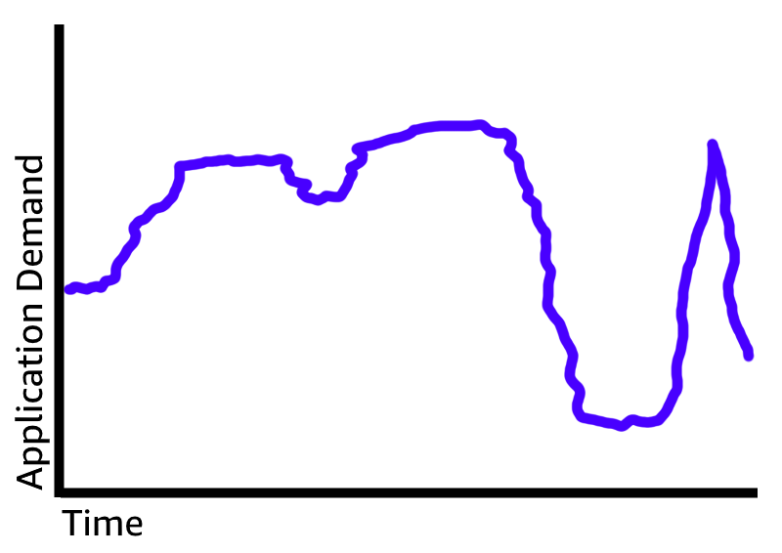

Stop guessing capacity
Overestimated server capacity
Underestimated server capacity
Scaling on demand
Notes:
Advantage #3—Stop guessing capacity: Eliminate guessing about your infrastructure capacity needs. When you make a capacity decision before you deploy an application, you often either have expensive idle resources or deal with limited capacity. With cloud computing, these problems go away. You can access as much or as little as you need, and scale up and down as required with only a few minutes’ notice.

Slide 29
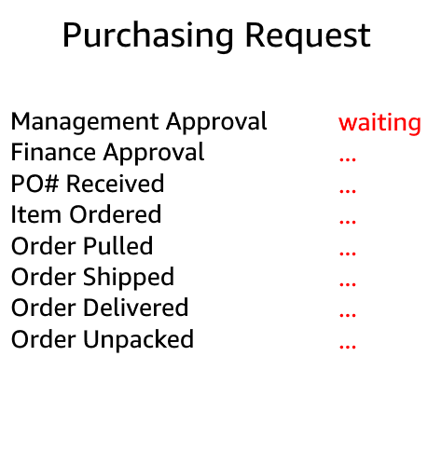

Increase speed and agility
Launch
Weeks between wanting resources and having resources
Minutes between wanting resources and having resources
Notes:
Advantage #4—Increase speed and agility: In a cloud computing environment, new IT resources are only a click away, which means that you reduce the time it takes to make those resources available to your developers from weeks to just minutes. The result is a dramatic increase in agility for the organization because the cost and time that it takes to experiment and develop are significantly lower.

Slide 30
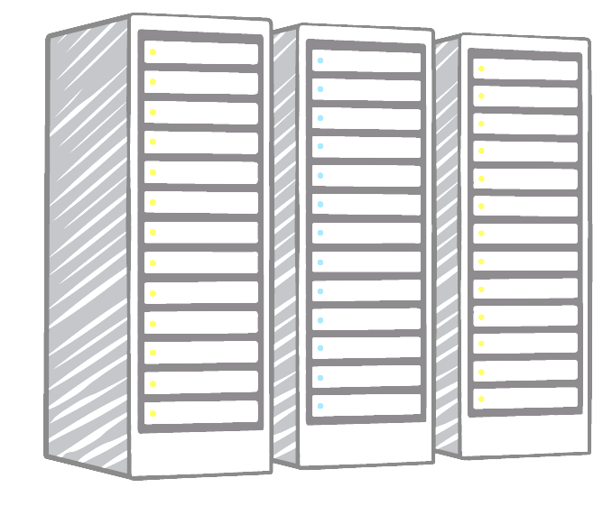



Stop spending money on running and maintaining data centers
Payroll …. … .. … …. … .. … …. … .. … …. … .. … …. … .. … …. … .. …
Utilities …. … .. … …. … .. … …. … .. … …. … .. … …. … .. … …. … .. …
Maintenance …. … .. … …. … .. … …. … .. … …. … .. … …. … .. … …. … .. …
Landscaping …. … .. … …. … .. … …. … .. … …. … .. … …. … .. … …. … .. …
Hardware …. … .. … …. … .. … …. … .. … …. … .. … …. … .. … …. … .. …
Investment
Running data centers
Business and customers
Notes:
Advantage #5—Stop spending money on running and maintaining data centers: Focus on projects that differentiate your business instead of focusing on the infrastructure. Cloud computing enables you to focus on your own customers instead of the heavy lifting of racking, stacking, and powering servers.

Slide 31
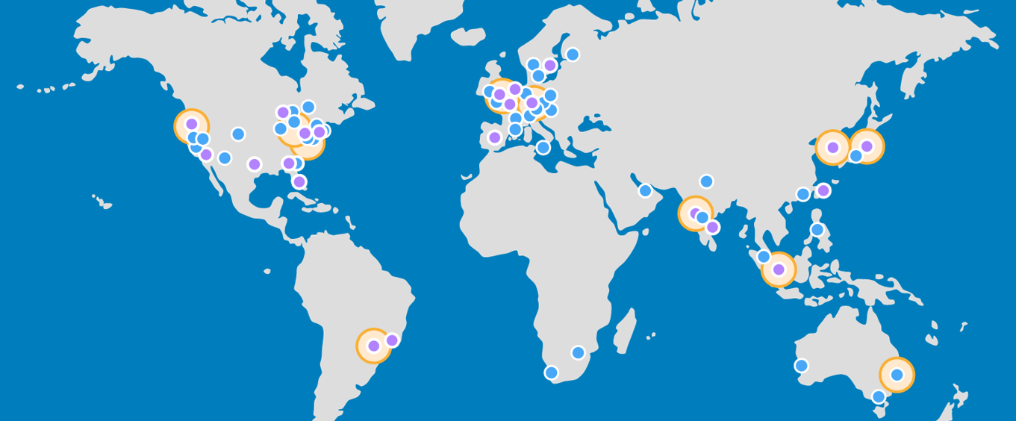

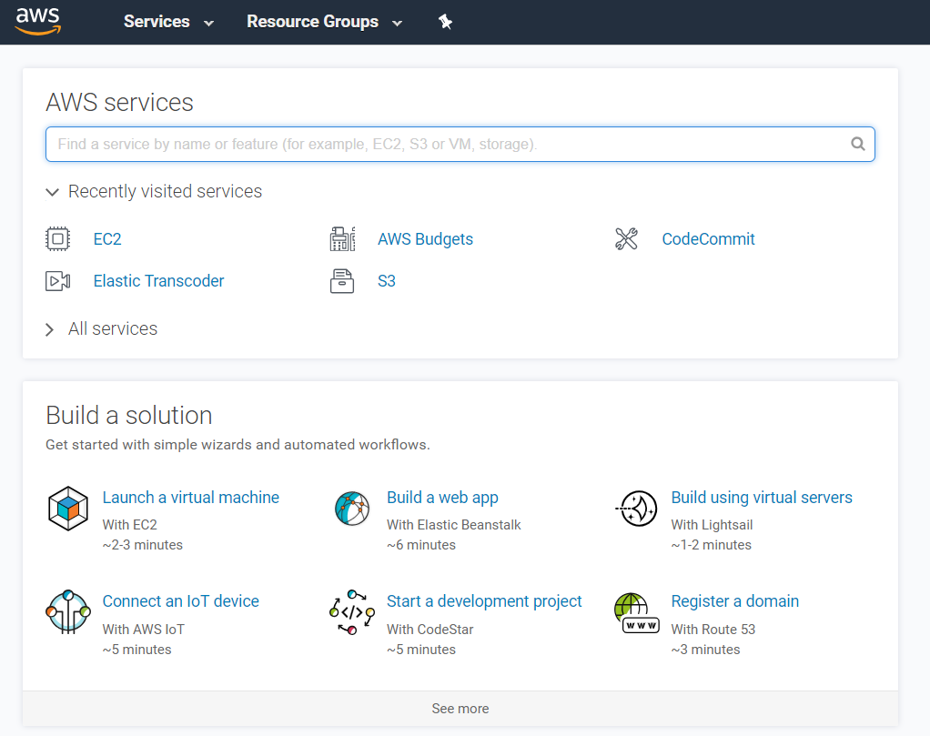
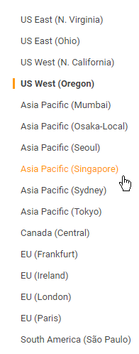



Go global in minutes
Notes:
Advantage #6—Go global in minutes: You can deploy your application in multiple AWS Regions around the world with just a few clicks. As a result, you can provide a lower latency and better experience for your customers simply and at minimal cost.

Slide 32
Section 2 key takeaways
Trade capital expense for variable expense
Benefit from massive economies of scale
Stop guessing capacity
Increase speed and agility
Stop spending money on running and maintaining data centers
Go global in minutes
Notes:
The key takeaways from this section of the module include the six advantages of cloud computing:
Trade capital expense for variable expense
Massive economies of scale
Stop guessing capacity
Increase speed and agility
Stop spending money on running and maintaining data centers
Go global in minutes

Slide 33
Section 3: Introduction to Amazon Web Services (AWS)
Module 1: Cloud Concepts Overview
Notes:
Section 3: Introduction to Amazon Web Services (AWS)

Slide 34

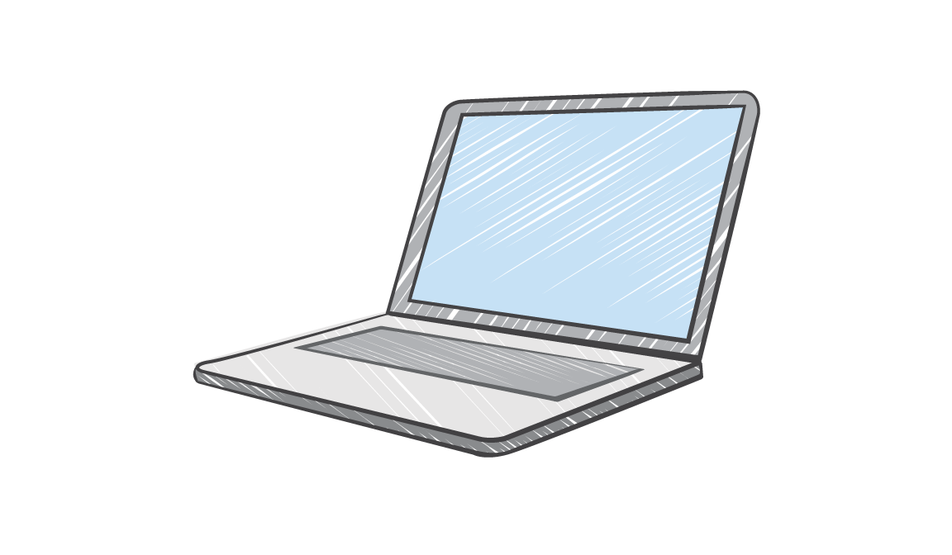

What are web services?
A web service is any piece of software that makes itself available over the internet and uses a standardized format—such as Extensible Markup Language (XML) or JavaScript Object Notation (JSON)—for the request and the response of an application programming interface (API) interaction.
Request message
Internet
Response message
Client
Web service
Notes:
In general, a web service is any piece of software that makes itself available over the internet or on private (intranet) networks. A web service uses a standardized format—such as Extensible Markup Language (XML) or JavaScript Object Notation (JSON)—for the request and the response of an application programming interface (API) interaction. It is not tied to any one operating system or programming language. It’s self-describing via an interface definition file and it is discoverable.

Slide 35
What is AWS?
AWS is a secure cloud platform that offers a broad set of global cloud-based products.
AWS provides you with on-demand access to compute, storage, network, database, and other IT resources and management tools.
AWS offers flexibility.
You pay only for the individual services you need, for as long as you use them.
AWS services work together like building blocks.
Notes:
Amazon Web Services (AWS) is a secure cloud platform that offers a broad set of global cloud-based products. Because these products are delivered over the internet, you have on-demand access to the compute, storage, network, database, and other IT resources that you might need for your projects—and the tools to manage them. You can immediately provision and launch AWS resources. The resources are ready for you to use in minutes.
AWS offers flexibility. Your AWS environment can be reconfigured and updated on demand, scaled up or down automatically to meet usage patterns and optimize spending, or shut down temporarily or permanently. The billing for AWS services becomes an operational expense instead of a capital expense.
AWS services are designed to work together to support virtually any type of application or workload. Think of these services like building blocks, which you can assemble quickly to build sophisticated, scalable solutions, and then adjust them as your needs change.

Slide 36








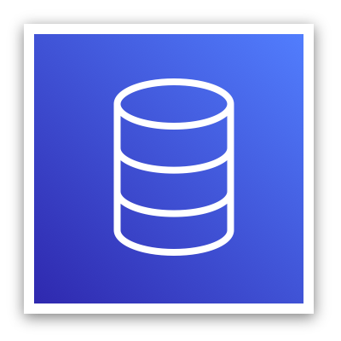

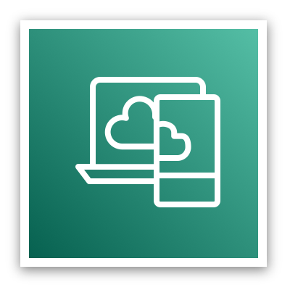



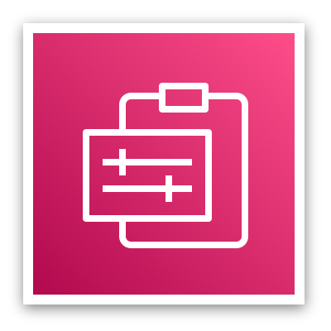



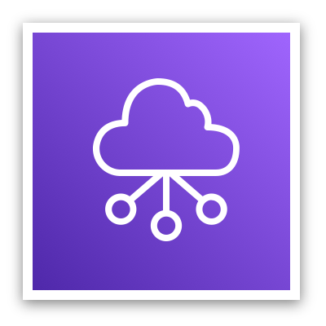



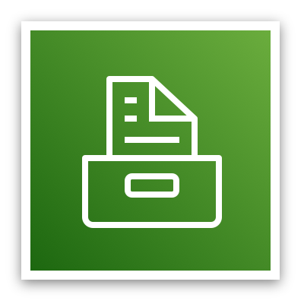
Categories of AWS services
Analytics
Application
Integration
AR and VR
Blockchain
Business Applications
Compute
Cost Management
Customer Engagement
Database
Developer Tools
End User
Computing
Game Tech
Internet of Things
Machine Learning
Management and Governance
Media Services
Migration and
Transfer
Mobile
Networking and
Content Delivery
Robotics
Satellite
Security, Identity, and
Compliance
Storage
Notes:
AWS services fall under different categories, and each category contains one or more services. You can select the services that you want from these different categories to build your solutions.

Slide 37


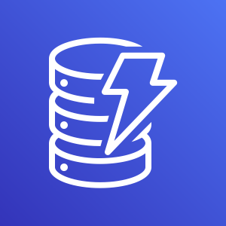


Simple solution example
Networking
Compute
Database
Storage
AWS Cloud
Virtual Private Cloud (VPC)
Amazon DynamoDB
Users
Amazon S3
Amazon EC2
Notes:
For example, say you’re building a database application. Your customers might be sending data to your Amazon Elastic Compute Cloud (Amazon EC2) instances, which is a service in the compute category. These EC2 servers batch the data in one-minute increments and add an object per customer to Amazon Simple Storage Service (Amazon S3), the AWS storage service you’ve chosen to use. You can then use a nonrelational database like Amazon DynamoDB to power your application, for example, to build an index so that you can find all the objects for a given customer that were collected over a certain period. You might decide to run these services inside an Amazon Virtual Private Cloud (Amazon VPC), which is a service in the networking category.
The purpose of this simple example is to illustrate that you can select web services from different categories and use them together to build a solution (in this case, a database application). Of course, the solutions you build can be quite complex.

Slide 38

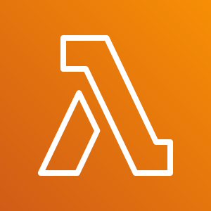

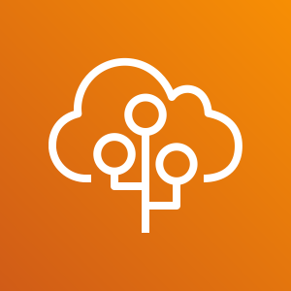
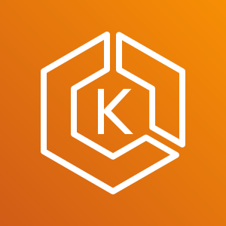
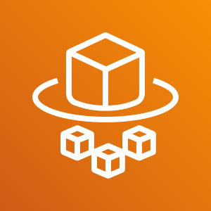

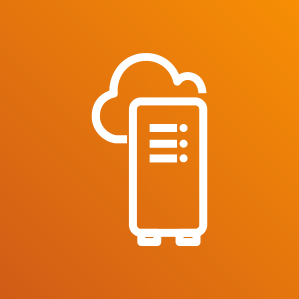

Choosing a service
The service you select depends on your business goals and technology requirements.
Amazon EC2
VMware Cloud on AWS
AWS Lambda
?
Amazon ECS
AWS Elastic Beanstalk
Amazon EKS
AWS Fargate
Amazon Lightsail
AWS Outposts
AWS Batch
Notes:
Which service you choose to use will depend on your business goals and technology requirements. In the example you just looked at, the solution made use of Amazon EC2 as the compute service. However, that is only one of many compute services that AWS offers. Here are some other AWS compute offerings that you might choose to use for the following example use cases:
Amazon EC2 (https://aws.amazon.com/ec2/): You want complete control over your AWS computing resources.
AWS Lambda (https://aws.amazon.com/lambda/): You want to run your code and not manage or provision servers.
AWS Elastic Beanstalk (https://aws.amazon.com/elasticbeanstalk/): You want a service that deploys, manages, and scales your web applications for you.
Amazon Lightsail (https://aws.amazon.com/lightsail/): You need a lightweight cloud platform for a simple web application.
AWS Batch (https://aws.amazon.com/batch/): You need to run hundreds of thousands of batch workloads.
AWS Outposts (https://aws.amazon.com/outposts/): You want to run AWS infrastructure in your on-premises data center.
Amazon Elastic Container Service (Amazon ECS) (https://aws.amazon.com/ecs/)
Amazon Elastic Kubernetes Service (Amazon EKS) (https://aws.amazon.com/eks/)
AWS Fargate (https://aws.amazon.com/fargate/): You want to implement a containers or microservices architecture.
VMware Cloud on AWS (https://aws.amazon.com/vmware/): You have an on-premises server virtualization platform that you want to migrate to AWS.
Similarly, there are a variety of services for you to choose from in the other categories, and the number of offerings keeps growing.

Slide 39
Services covered in this course
Compute services –
Amazon EC2
AWS Lambda
AWS Elastic Beanstalk
Amazon EC2 Auto Scaling
Amazon ECS
Amazon EKS
Amazon ECR
AWS Fargate
Storage services –
Amazon S3
Amazon S3 Glacier
Amazon EFS
Amazon EBS
Management and Governance services –
AWS Trusted Advisor
AWS CloudWatch
AWS CloudTrail
AWS Well-Architected Tool
AWS Auto Scaling
AWS Command Line Interface
AWS Config
AWS Management Console
AWS Organizations
Database services –
Amazon RDS
Amazon DynamoDB
Amazon Redshift
Amazon Aurora
Security, Identity, and Compliance services –
AWS IAM
Amazon Cognito
AWS Shield
AWS Artifact
AWS KMS
Networking and Content Delivery services –
Amazon VPC
Amazon Route 53
Amazon CloudFront
Elastic Load Balancing
AWS Cost Management services –
AWS Cost & Usage Report
AWS Budgets
AWS Cost Explorer
Notes:
The array of AWS services can be intimidating as you start your journey into the cloud. This course focuses on some of the more common services in the following service categories: compute, storage, database, networking and content delivery, security, identity, and compliance, management and governance, and AWS cost management.
Legend:
Amazon Elastic Block Store (Amazon EBS)
Amazon Elastic Compute Cloud (Amazon EC2)
Amazon Elastic Container Registry (Amazon ECR)
Amazon Elastic Container Service (Amazon ECS)
Amazon Elastic File System (Amazon EFS)
Amazon Elastic Kubernetes Service (Amazon EKS)
Amazon Relational Database Service (Amazon RDS)
Amazon Simple Storage Service (Amazon S3)
Amazon Virtual Private Cloud (Amazon VPC)
AWS Identity and Access Management (IAM)
AWS Key Management Service (AWS KMS)

Slide 40
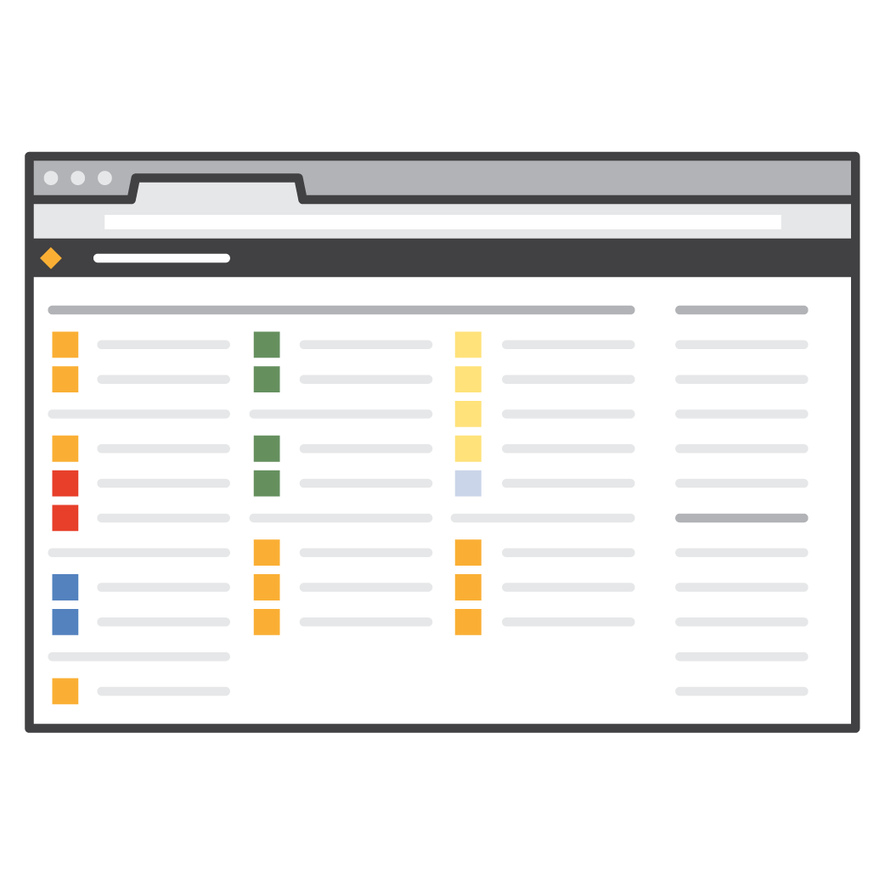
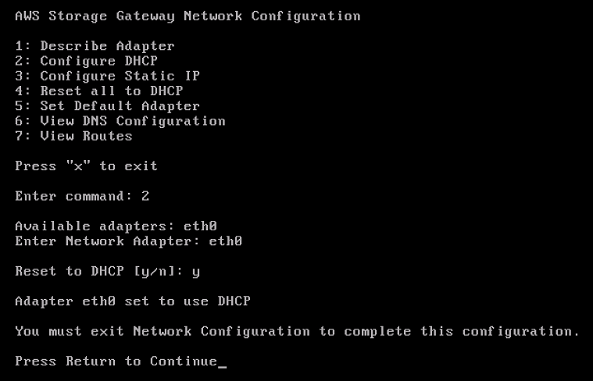
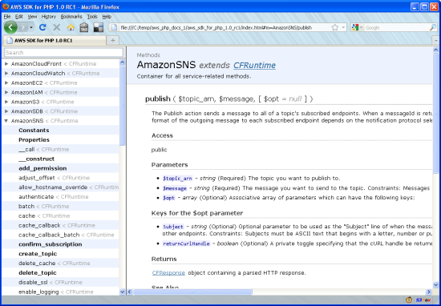
Three ways to interact with AWS
AWS Management Console
Easy-to-use graphical interface
Command Line Interface (AWS CLI)
Access to services by discrete commands or scripts
Software Development Kits (SDKs)
Access services directly from your code (such as Java, Python, and others)
Notes:
You might wonder how to access the broad array of services that are offered by AWS. There are three ways to create and manage resources on the AWS Cloud:
AWS Management Console: The console provides a rich graphical interface to a majority of the features offered by AWS. (Note: From time to time, new features might not have all of their capabilities included in the console when the feature initially launches.)
AWS Command Line Interface (AWS CLI): The AWS CLI provides a suite of utilities that can be launched from a command script in Linux, macOS, or Microsoft Windows.
Software development kits (SDKs): AWS provides packages that enable accessing AWS in a variety of popular programming languages. This makes it easy to use AWS in your existing applications and it also enables you to create applications that deploy and monitor complex systems entirely through code.
All three options are built on a common REST-like API that serves as the foundation of AWS.
To learn more about tools you can use to develop and manage applications on AWS, see https://aws.amazon.com/tools/.

Slide 41
Section 3 key takeaways
AWS is a secure cloud platform that offers a broad set of global cloud-based products called services that are designed to work together.
There are many categories of AWS services, and each category has many services to choose from.
Choose a service based on your business goals and technology requirements.
There are three ways to interact with AWS services.
Notes:
The key takeaways from this section of the module include:
AWS is a secure cloud platform that offers a broad set of global cloud-based products called services that are designed to work together.
There are many categories of AWS services, and each category has many services to choose from.
Choose a service based on your business goals and technology requirements.
There are three ways to interact with AWS services.

Slide 42
Section 4: Moving to the AWS Cloud – The AWS Cloud Adoption Framework (AWS CAF)
Module 1: Cloud Concepts Overview
Notes:
Section 4: Moving to the AWS Cloud – The AWS Cloud Adoption Framework (AWS CAF)
As you learned so far in this module, cloud computing offers many advantages over the traditional model. However, for most organizations, cloud adoption does not happen instantly. Technology is one thing, but an organization also consists of people and processes, and these three elements must all be in alignment for successful cloud adoption. Cloud computing introduces a significant shift in how technology is obtained, used, and managed. It also shifts how organizations budget and pay for technology services. Cloud adoption requires that fundamental changes are discussed and considered across an entire organization. It also requires that stakeholders across all organizational units—both within and outside IT—support these new changes. In this last section, you learn about the AWS CAF, which was created to help organizations design and travel an accelerated path to successful cloud adoption.

Slide 43
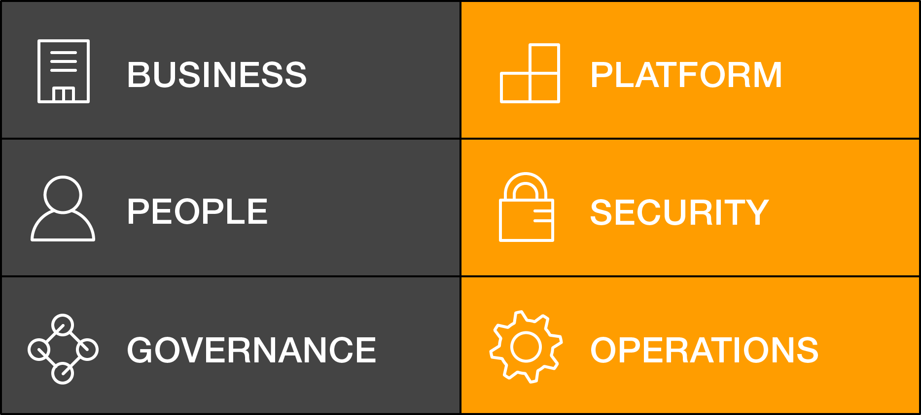
AWS Cloud Adoption Framework (AWS CAF)
AWS CAF provides guidance and best practices to help organizations build a comprehensive approach to cloud computing across the organization and throughout the IT lifecycle to accelerate successful cloud adoption.
AWS CAF is organized into six perspectives.
Perspectives consist of sets of capabilities.
AWS CAF perspectives
Notes:
Each organization’s cloud adoption journey is unique. However, in order for any organization to successfully migrate its IT portfolio to the cloud, three elements (that is, people, process, and technology) must be in alignment. Business and technology leaders in an organization must understand the organization’s current state, target state, and the transition that is needed to achieve the target state so they can set goals and create processes for staff.
The AWS Cloud Adoption Framework (AWS CAF) provides guidance and best practices to help organizations identify gaps in skills and processes. It also helps organizations build a comprehensive approach to cloud computing—both across the organization and throughout the IT lifecycle—to accelerate successful cloud adoption.
At the highest level, the AWS CAF organizes guidance into six areas of focus, called perspectives. Perspectives span people, processes, and technology. Each perspective consists of a set of capabilities, which covers distinct responsibilities that are owned or managed by functionally related stakeholders.
Capabilities within each perspective are used to identify which areas of an organization require attention. By identifying gaps, prescriptive work streams can be created that support a successful cloud journey.

Slide 44
Six core perspectives
Focus on business capabilities
Focus on technical capabilities
Notes:
In general, the Business, People, and Governance perspectives focus on business capabilities, while the Platform, Security, and Operations perspectives focus on technical capabilities.

Slide 45
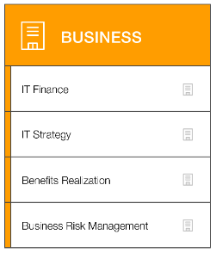
Business perspective
We must ensure that IT is aligned with business needs, and that IT investments can be traced to demonstrable business results.
IT finance
IT strategy
Benefits realization
Business risk management
Business managers, finance managers, budget owners, and strategy stakeholders
Business perspective capabilities
Notes:
Stakeholders from the Business perspective (for example, business managers, finance managers, budget owners, and strategy stakeholders) can use the AWS CAF to create a strong business case for cloud adoption and prioritize cloud adoption initiatives. Stakeholders should ensure that an organization’s business strategies and goals align with its IT strategies and goals.

Slide 46
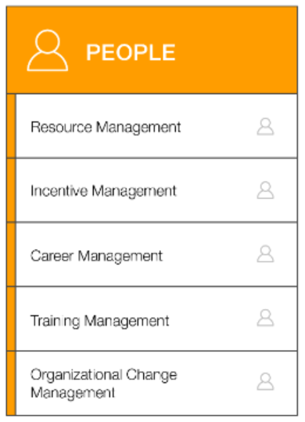
People perspective
We must prioritize training, staffing, and organizational changes to build an agile organization.
Resource management
Incentive management
Career management
Training management
Organizational change management
Human resources, staffing, and people managers
People perspective capabilities
Notes:
Stakeholders from the People perspective (for example, human resources, staffing, and people managers) can use the AWS CAF to evaluate organizational structures and roles, new skill and process requirements, and identify gaps. Performing an analysis of needs and gaps can help prioritize training, staffing, and organizational changes to build an agile organization.

Slide 47
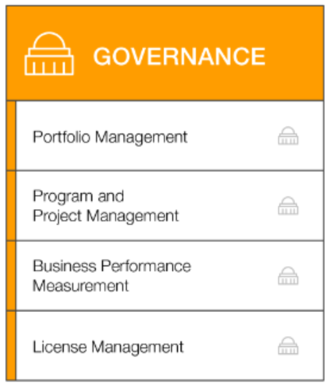
Governance perspective
We must ensure that skills and processes align IT strategy and goals with business strategy and goals so the organization can maximize the business value of its IT investment and minimize business risks.
Portfolio management
Program and project management
Business performance measurement
License management
Governance perspective capabilities
CIO, program managers, enterprise architects, business analysts, and portfolio managers
Notes:
Stakeholders from the Governance perspective (for example, the Chief Information Officer or CIO, program managers, enterprise architects, business analysts, and portfolio managers) can use the AWS CAF to focus on the skills and processes that are needed to align IT strategy and goals with business strategy and goals. This focus helps the organization maximize the business value of its IT investment and minimize the business risks.

Slide 48
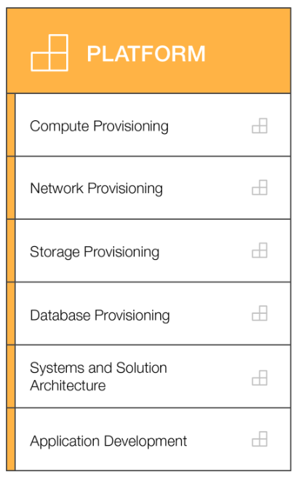
Platform perspective
We must understand and communicate the nature of IT systems and their relationships. We must be able to describe the architecture of the target state environment in detail.
Compute provisioning
Network provisioning
Storage provisioning
Database provisioning
Systems and solution architecture
CTO, IT managers, and solutions architects
Application development
Platform perspective capabilities
Notes:
Stakeholders from the Platform perspective (for example, Chief Technology Officer or CTO, IT managers, and solutions architects) use a variety of architectural dimensions and models to understand and communicate the nature of IT systems and their relationships. They must be able to describe the architecture of the target state environment in detail. The AWS CAF includes principles and patterns for implementing new solutions on the cloud, and for migrating on-premises workloads to the cloud.

Slide 49
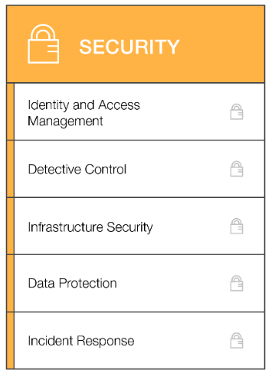
Security perspective
We must ensure that the organization meets its security objectives.
Identity and access management
Detective control
Infrastructure security
Data protection
CISO, IT security managers, and IT security analysts
Incident response
Security perspective capabilities
Notes:
Stakeholders from the Security perspective (for example, Chief Information Security Officer or CISO, IT security managers, and IT security analysts) must ensure that the organization meets security objectives for visibility, auditability, control, and agility. Security perspective stakeholders can use the AWS CAF to structure the selection and implementation of security controls that meet the organization’s needs.

Slide 50
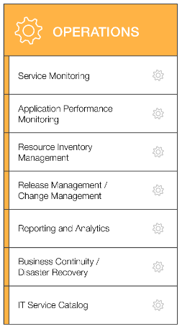
Operations perspective
We align with and support the operations of the business, and define how day-to-day, quarter-to-quarter, and year-to-year business will be conducted.
Service monitoring
Application performance monitoring
Resource inventory management
Release management/ change management
Reporting and analytics
Business continuity/ Disaster recovery
IT operations managers and IT support managers
IT service catalog
Operations perspective capabilities
Notes:
Stakeholders from the Operations perspective (for example, IT operations managers and IT support managers) define how day-to-day, quarter-to-quarter, and year-to-year business is conducted. Stakeholders from the Operations perspective align with and support the operations of the business. The AWS CAF helps these stakeholders define current operating procedures. It also helps them identify the process changes and training that are needed to implement successful cloud adoption.

Slide 51
Section 4 key takeaways
Cloud adoption is not instantaneous for most organizations and requires a thoughtful, deliberate strategy and alignment across the whole organization.
The AWS CAF was created to help organizations develop efficient and effective plans for their cloud adoption journey.
The AWS CAF organizes guidance into six areas of focus, called perspectives.
Perspectives consist of sets of business or technology capabilities that are the responsibility of key stakeholders.
Notes:
The key takeaways from this section of the module include:
Cloud adoption is not instantaneous for most organizations and requires a thoughtful, deliberate strategy and alignment across the whole organization.
The AWS CAF was created to help organizations develop efficient and effective plans for their cloud adoption journey.
The AWS CAF organizes guidance into six areas of focus, called perspectives.
Perspectives consist of sets of business or technology capabilities that are the responsibility of key stakeholders.

Slide 52
Module wrap-up
Module 1: Cloud Concepts Overview
Notes:
It’s now time to review the module, and wrap up with a knowledge check and discussion of a practice certification exam question.

Slide 53
Module summary
In summary, in this module you learned how to:
Define different types of cloud computing models
Describe six advantages of cloud computing
Recognize the main AWS service categories and core services
Review the AWS Cloud Adoption Framework
Notes:
In summary, in this module you learned how to:
Define different types of cloud computing
Describe six advantages of cloud computing
Recognize the main AWS service categories and core services
Reviewed the AWS Cloud Adoption Framework
To finish this module, complete the knowledge check.

Slide 54

Complete the knowledge check
Notes:
Now, complete the knowledge check.

Slide 55
Sample exam question
Why is AWS more economical than traditional data centers for applications with varying compute workloads?
Choice
Response
A
Amazon Elastic Compute Cloud (Amazon EC2) costs are billed on a monthly basis.
B
Customers retain full administrative access to their Amazon EC2 instances.
C
Amazon EC2 instances can be launched on-demand when needed.
D
Customers can permanently run enough instances to handle peak workloads.
Notes:
Look at the answer choices and rule them out based on the keywords.

Slide 56
Sample exam question answer
Why is AWS more economical than traditional data centers for applications with varying compute workloads?
The correct answer is C.
The keywords in the question are AWS is more economical than traditional data centers for applications with varying.
Notes:
The following are the keywords to recognize: AWS is more economical than traditional data centers for applications with varying.
The correct answer is C. Amazon EC2 instances can be launched on-demand when needed.
Incorrect answers:
Answer A: Amazon Elastic Compute Cloud (Amazon EC2) costs are billed on a monthly basis.
Answer B: Customers retain full administrative access to their Amazon EC2 instances.
Answer D: Customers can permanently run enough instances to handle peak workloads.

Slide 57
Additional resources
What is AWS? YouTube video: https://www.youtube.com/watch?v=mZ5H8sn_2ZI&feature=youtu.be
Cloud computing with AWS website: https://aws.amazon.com/what-is-aws/
Overview of Amazon Web Services whitepaper: https://d1.awsstatic.com/whitepapers/aws-overview.pdf
An Overview of the AWS Cloud Adoption Framework whitepaper: https://d1.awsstatic.com/whitepapers/aws_cloud_adoption_framework.pdf
6 Strategies for Migrating Applications to the Cloud AWS Cloud Enterprise Strategy blog post: https://aws.amazon.com/blogs/enterprise-strategy/6-strategies-for-migrating-applications-to-the-cloud/
Notes:
If you want to learn more about the topics covered in this module, you might find the following additional resources helpful:
What is AWS? YouTube video: https://www.youtube.com/watch?v=mZ5H8sn_2ZI&feature=youtu.be
Cloud computing with AWS website: https://aws.amazon.com/what-is-aws/
Overview of Web Services whitepaper: https://d1.awsstatic.com/whitepapers/aws-overview.pdf
An Overview of the AWS Cloud Adoption Framework whitepaper: https://d1.awsstatic.com/whitepapers/aws_cloud_adoption_framework.pdf
6 Strategies for Migrating Applications to the Cloud AWS Cloud Enterprise Strategy blog post: https://aws.amazon.com/blogs/enterprise-strategy/6-strategies-for-migrating-applications-to-the-cloud/

Slide 58
Thank you
All trademarks are the property of their owners.
Notes:
Thank you for completing this module.

